Slide 1
C++ Programming Design
Session #0

Slide 2
Wishes
疫情就是课堂，希望同学们学会敬畏生命、崇尚科学、保护环境、锻炼身体，扎扎实实地学习，健健康康地成长。
李兰娟院士
Notes:
73岁高龄的中科院院士（2020），2020年2月24日，杭州文龙巷小学向全体学生发起了致敬“抗疫英雄”李兰娟院士的活动，一、二年级的小朋友通过画笔表达心意，三到六年级的同学通过书信传递敬意。李兰娟院士在回信中写到这句话。

Slide 3
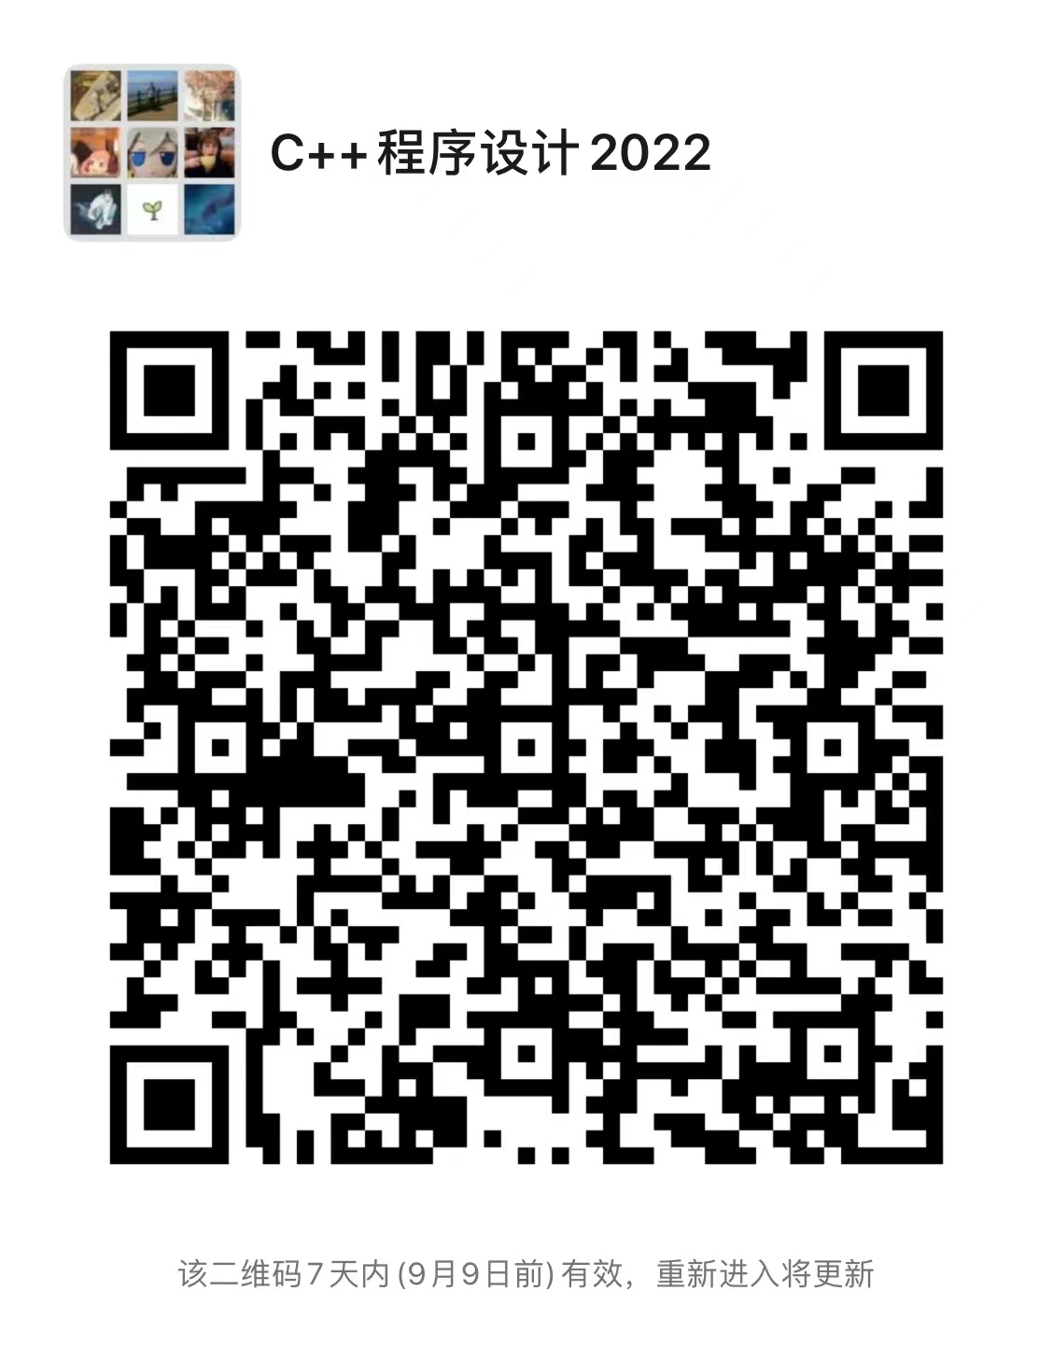
About Course
主讲教师：李宗辉
lizonghui@bjtu.edu.cn
办公室：九教西209室
助教：靳淑娴
22125186@bjtu.edu.cn
助教：邱忠心
22125218@bjtu.edu.cn

Slide 4
Class description
32 Hours
16 sessions of 2 hours each
English
Self learning method

Slide 5
Session schedule
2h lecture
exercise
Each exercise will have to be finished the next week
Submitted to 课程平台 or Email

Slide 6
Score calculation
40% homework
60% final checking

Slide 7
References
C++ primer plus, 6th
C++ primer, 5th
and so on

Slide 8
Plan

Slide 9
Course Content
C++ basic
C++ procedural programming
Class and object
Inheritance
Polymorphism
Friend and static member
Template
Standard template library (STL)
New C++ standard

Slide 10
Course Content
Learning Method
Practice is more important than theory

